Slide 1
NLP Classification

Slide 2

Problem Statement
Evaluation Metrics
The Data
Feature Engineering
Model Building Process
Model Selection
Final Model Performance
Model Interpretation

Slide 3
Problem statement
Train a classification model which will predict classes of subreddits for a given text.
audience
Data scientist colleague
Data Source
Subreddit ‘WorldNews’ & ‘Casual Conversation’

Slide 4
Evaluation Metrics
Precisian-Recall AUC
We cares more on predicting WorldNews (target)
Hence, we will be using PR-AUC metrics to select best model.
Baseline
Our baseline is 46% PR AUC score, our model at minimum must perform better than the baseline.

Slide 5
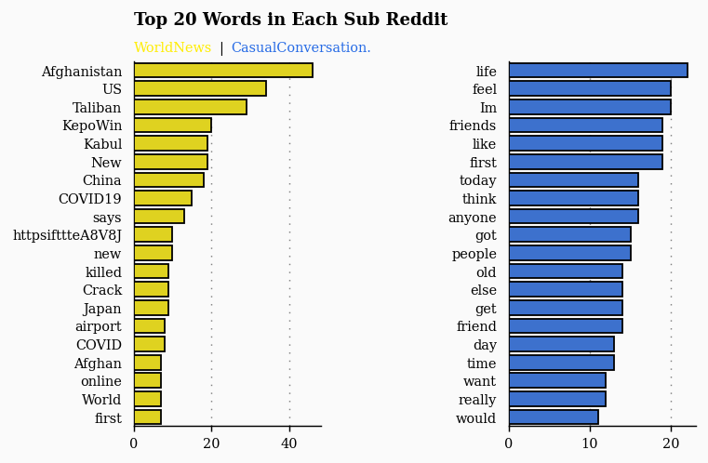
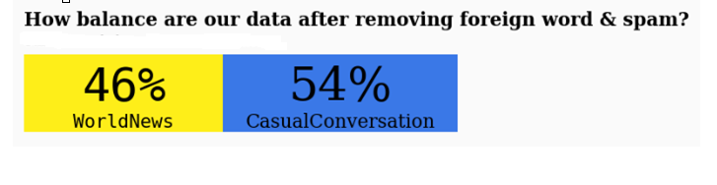
The Data
Removed

Slide 6
Feature Engineering
Count Vectorizer
Tf-idf Vectorizer
Pre-trained Word2vec (By Google on 2013)

Slide 7
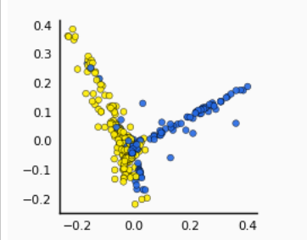
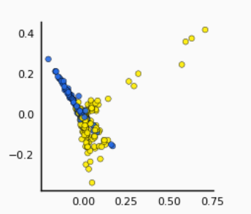
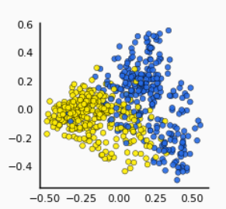
Pre-Processing
Pca Visualization
Count Vectorizer
Tf-idf Vectorizer
Word2Vec
PC2
PC2
PC2
PC1
PC1
PC1
Moderate separability
Moderate separability
Better Separability

Slide 8
Model Building Process
Model Training
5-fold
Cross Validation
(Grid Search)
Model Selection
(best validation score)
Final Model Performance on Test set
Feature Engineering
Count Vectorizer
Tf-idf Vectorizer
Google’s word2vec
Random Forest
Logistic Regression
Naïve Bayes
Random Forest
Max depth
Min samples split
Bootstrap
Logistic Regression
Alpha
Naïve Bayes
Alpha
Subsequent Slide
Subsequent Slide

Slide 9
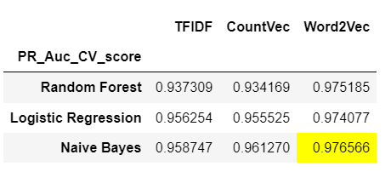
Model Selection
Word2vec model consistency perform better than other feature engineering,
This highlight the importance of data quality.

Slide 10
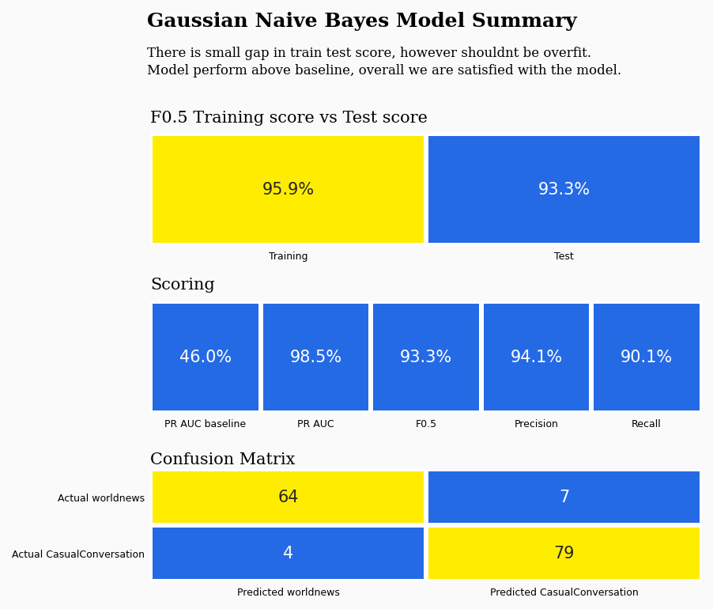
Final Model Performance

Slide 11
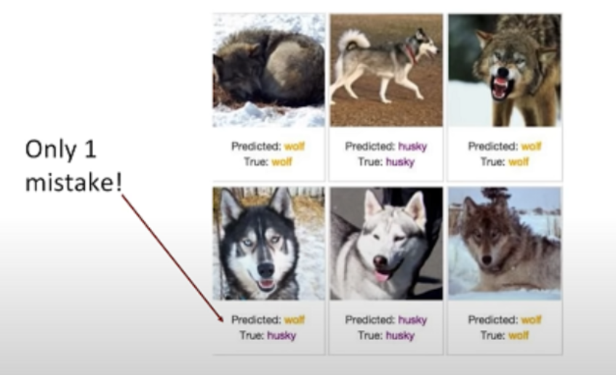
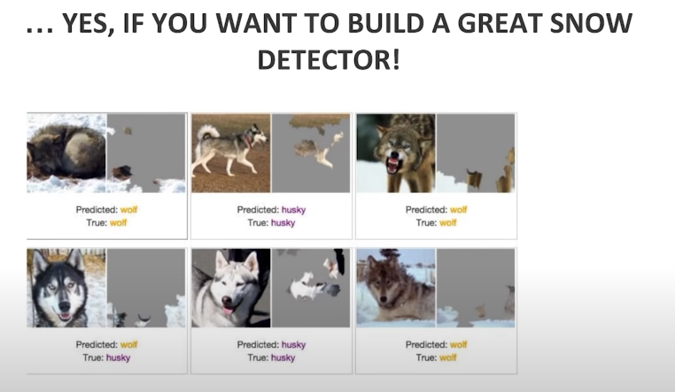
Model Interpretation
Never trust your model based on accuracy.

Slide 12
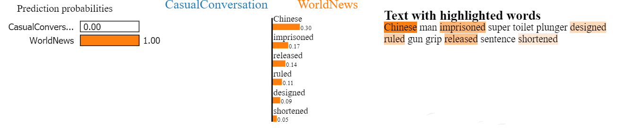
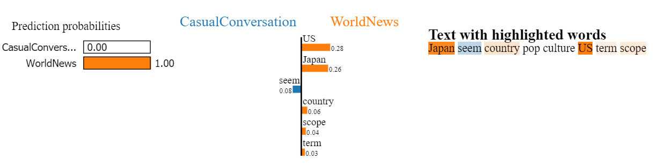
Model Interpretation
Local Interpretable Model-agnostic Explanations (LIME)
True Positive
False Positive
Although predicted wrongly, our model is making sensible prediction as seen in the highlight feature

Slide 13
Conclusion
Best performing model with F-score of 93%.
Based on the model interpretation, we are confidence that it will generalize.
Future :
Implement Topic modelling to understand the topics of a given text.

Slide 14
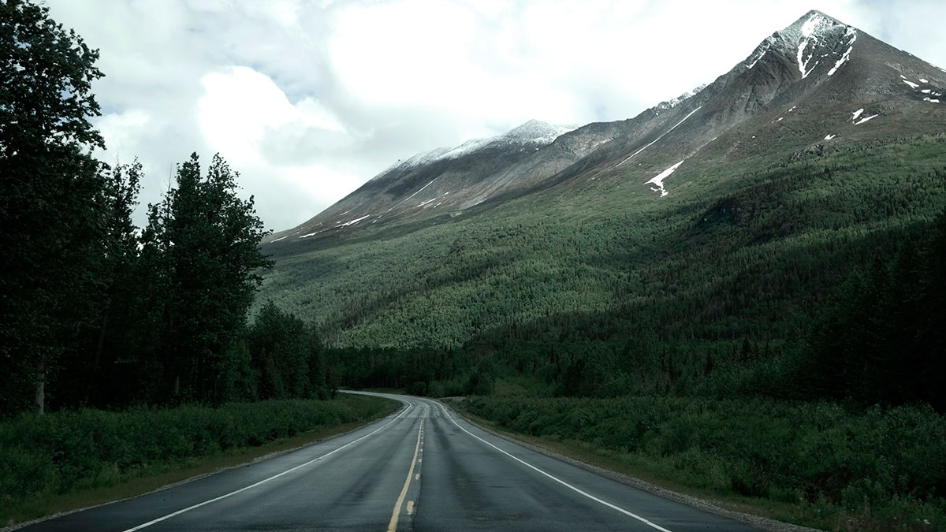
Thanks

